Slide 1




Lesson 2: Python Basic (1)
Haihua Chen, Ph.D.
9402200057
Haihua.chen@unt.edu

Slide 2

Agenda
1
Basic Syntax
2
Python Variables
3
Python Data Types
4
Python Operators
5
Python Files
6
Loop
7
Conditionals
8
In-class Quiz 1

Slide 3
1
Basic Syntax

Slide 4
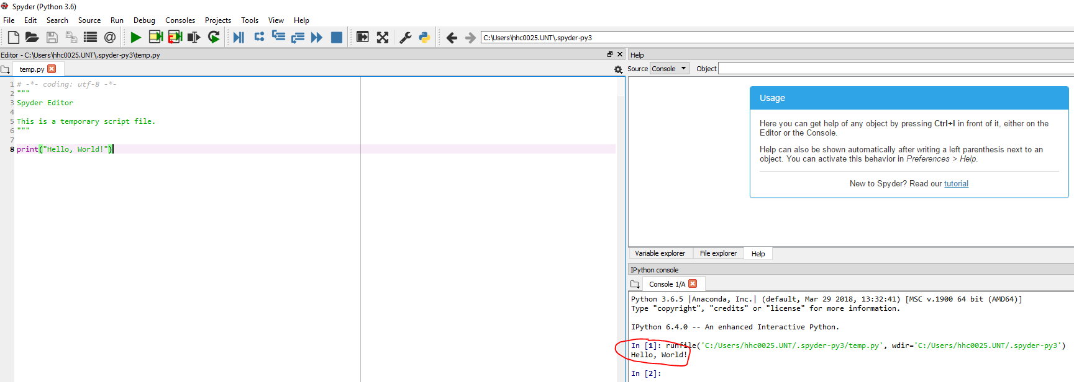




1. Execute Python Syntax
a high-level programming language like Java, C#, C++ et al.
Interpreter: immediate mode and script mode

Slide 5
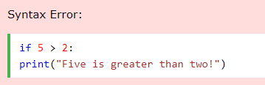

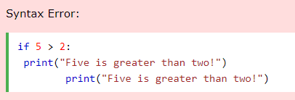
Python Indentation
Indentation refers to the spaces at the beginning of a code line.
Python uses indentation to indicate a block of code.

Slide 6
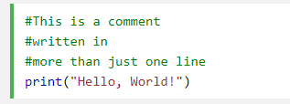
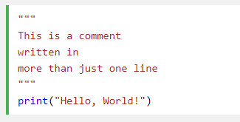



Python Comments
Comments can be used to explain Python code.
Comments can be used to make the code more readable.
Comments can be used to prevent execution when testing code.

Slide 7
2
Python Variables

Slide 8
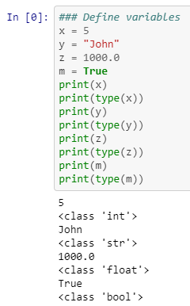
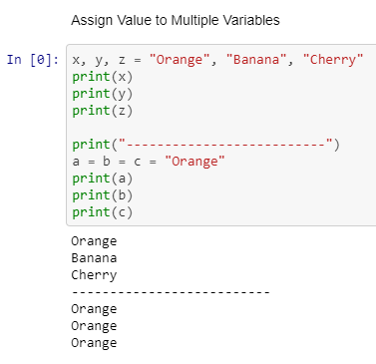
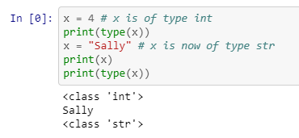
Variables
A variable is a name that refers to a value
A variable can have a short name (like x and y) or a more descriptive name (age, carname, total_volume)
A variable name must start with a letter or the underscore character
A variable name cannot start with a number
A variable name can only contain alpha-numeric characters and underscores (A-z, 0-9, and _ )
Variable names are case-sensitive

Slide 9
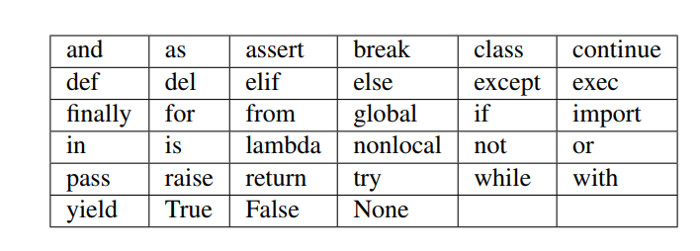
Variable names and keywords
These words can’t be used as variables

Slide 10
3
Python Data Types

Slide 11
Commonly used python data types
Data Type | Declaration
Numbers | a = 5
String | Single = 'Welcome‘ or Multi = "Welcome"
List | List = [2,4,5.5,"Hi"]
Tuple | Tuple = (50,15,25.6,"Python")
Set | Set = {5,1,2.6,"python"}
Dictionary | Dict = {1:'Hi',2:7.5, 3:'Class'}

Slide 12
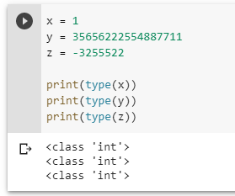
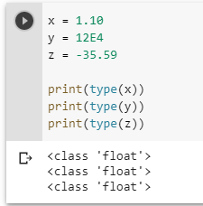
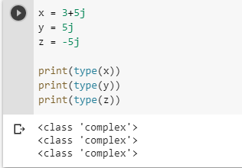
Python Numbers
int
float
complex

Slide 13
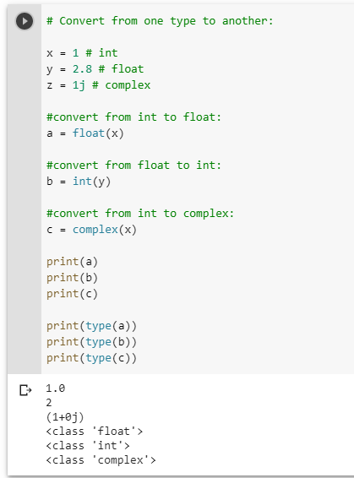
Python Numbers - Type Conversion
You can convert from one type to another with the int(), float(), and complex() methods

Slide 14
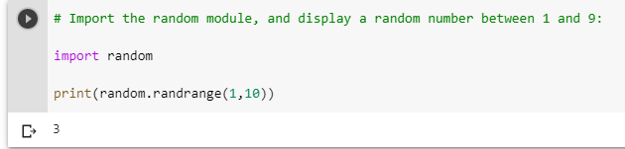
Python Numbers - Random Number
Python has a built-in module called random that can be used to make random numbers

Slide 15
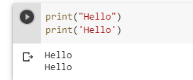
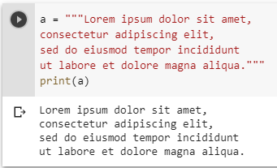



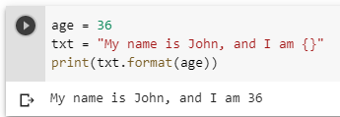
Python String
Either single quotation marks, or double quotation marks
Multiline Strings
Strings are Arrays: len(), strip(), lower(), upper(), replace(), split(), format()
Notes:
String Methods: https://www.w3schools.com/python/python_strings.asp

Slide 16



Python Casting
int() - constructs an integer number from an integer literal, a float literal, or a string literal
float() - constructs a float number from an integer literal, a float literal or a string literal
str() - constructs a string from a wide variety of data types, including strings, integer literals and float literals

Slide 17
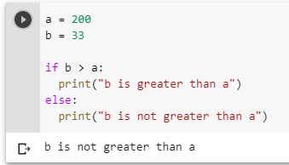
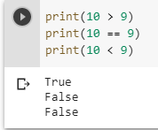
Python Booleans
Booleans represent one of two values: True or False.

Slide 18
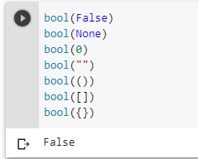
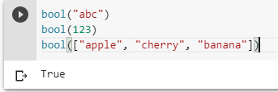
Python Booleans - Evaluate Values and Variables
Almost any value is evaluated to True if it has some sort of content.
Any string is True, except empty strings.
Any number is True, except 0.
Any list, tuple, set, and dictionary are True, except empty ones.
There are not many values that evaluates to False, except empty values, such as (), [], {}, "", the number 0, and the value None.

Slide 19

Python List
List is a collection which is ordered and changeable. Allows duplicate members.
W3schools_list: https://www.w3schools.com/python/python_lists.asp

Slide 20
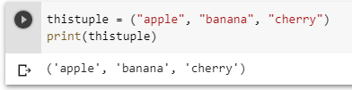
Python Tuple
Tuple is a collection which is ordered and unchangeable. Allows duplicate members.
W3schools_tuple: https://www.w3schools.com/python/python_tuples.asp

Slide 21

Python Set
Set is a collection which is unordered and unindexed. No duplicate members.
W3schools_set: https://www.w3schools.com/python/python_dictionaries.asp

Slide 22
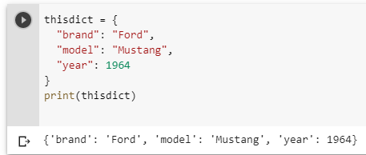
Python Dictionary
Dictionary is a collection which is unordered, changeable and indexed. No duplicate members.
W3schools_dictionary: https://www.w3schools.com/python/python_lists.asp

Slide 23
4
Python Operators

Slide 24
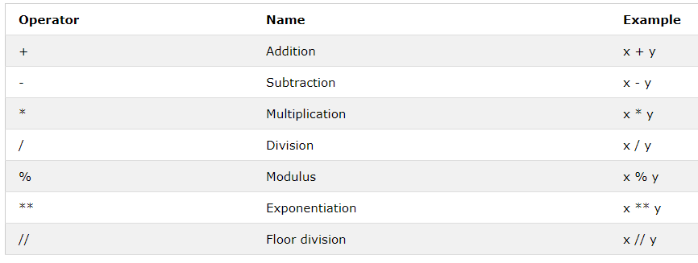
Python Operators - Arithmetic Operators
Arithmetic operators are used with numeric values to perform common mathematical operations

Slide 25
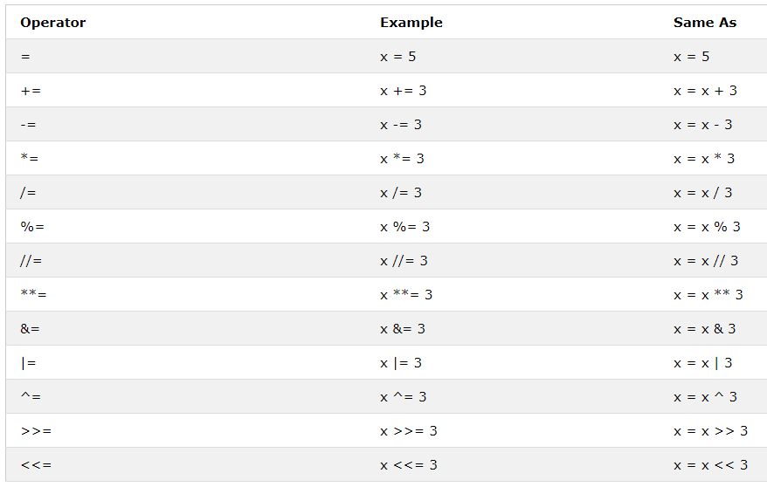
Python Operators - Assignment Operators
Assignment operators are used to assign values to variables

Slide 26
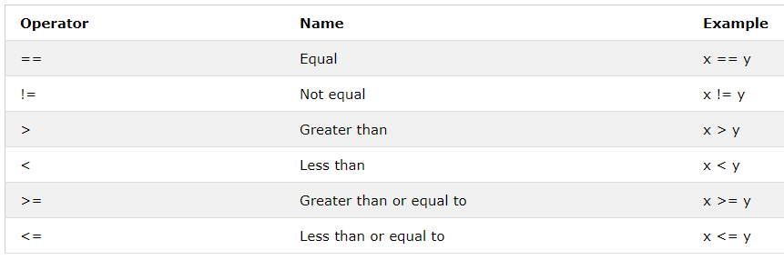
Python Operators - Comparison Operators
Comparison operators are used to compare two values

Slide 27
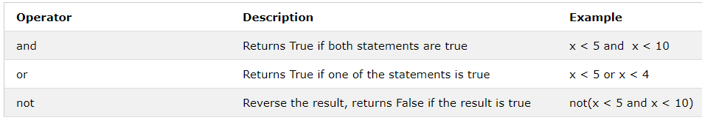
Python Operators - Logical Operators
Logical operators are used to combine conditional statements

Slide 28
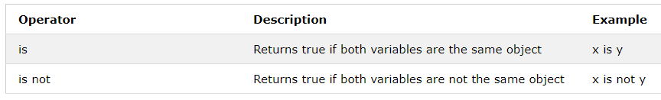
Python Operators - Identity Operators
Identity operators are used to compare the objects, not if they are equal, but if they are actually the same object, with the same memory location

Slide 29
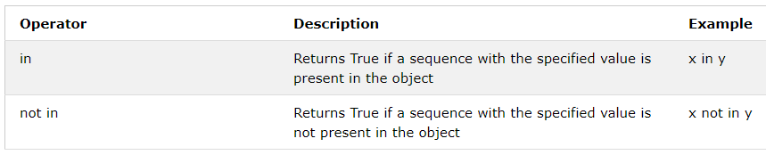
Python Operators - Membership Operators
Membership operators are used to test if a sequence is presented in an object:

Slide 30
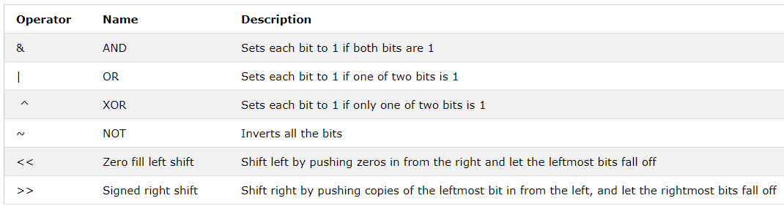
Python Operators - Bitwise Operators
Bitwise operators are used to compare (binary) numbers

Slide 31
5
Python Files

Slide 32
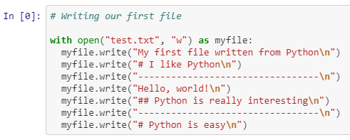
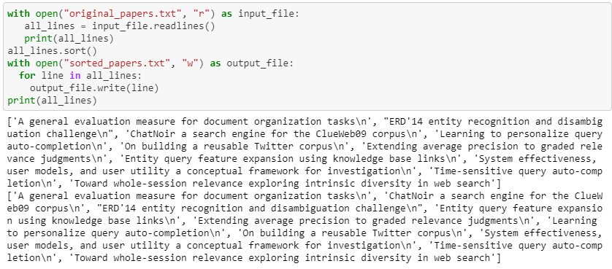
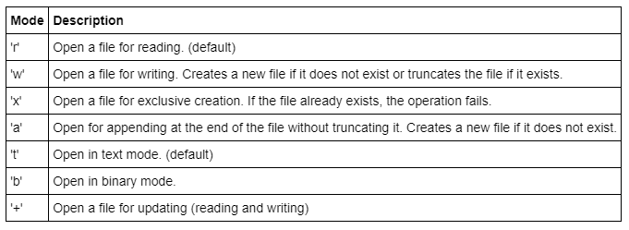
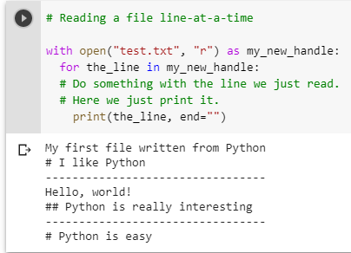
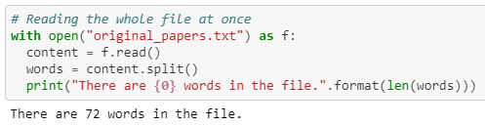
Reading and writing
To write a file, you have to open it with mode 'w' as a second parameter

Slide 33
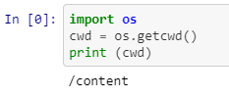




Filenames and paths
The os module provides functions for working with files and directories

Slide 34
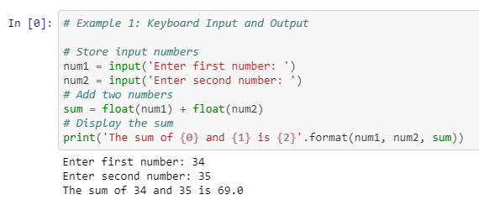
Input
Input is a built-in function in Python for getting input from the user
Name=input(“please enter your name:”)

Slide 35
6
Loop

Slide 36
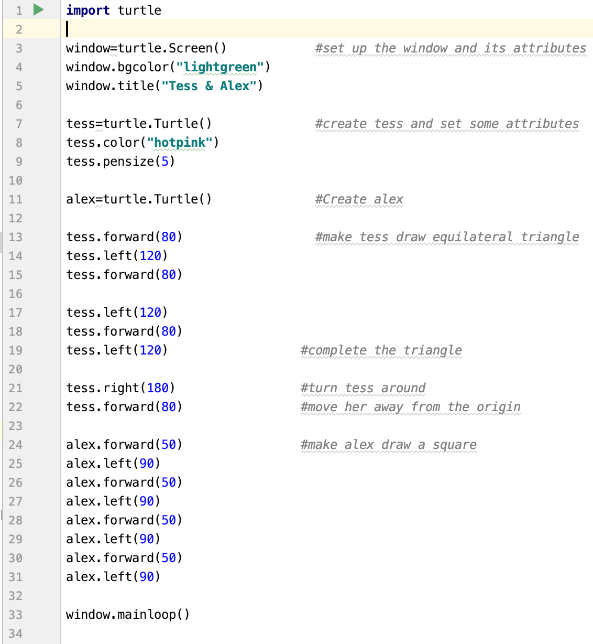

Problem Statement
It is really bad to repeat similar codes again and again.

Slide 37
for loop
Python’s for loop could solve this kind of problems
We want to invite several friends to join a party.

Slide 38
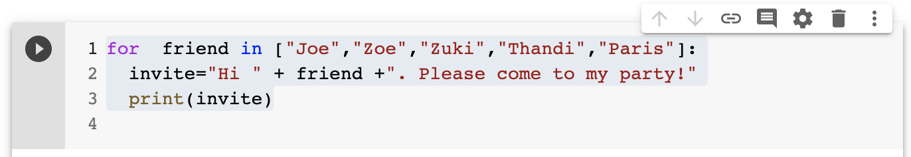
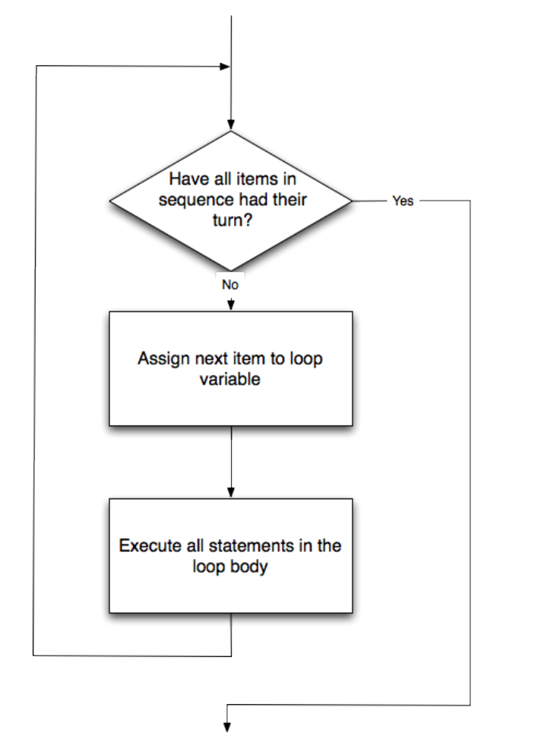
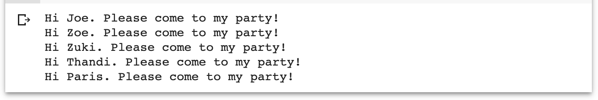
for loop – invite friends
friend in line 1 is called loop variable
Line 2 and 3 are loop body

Slide 39
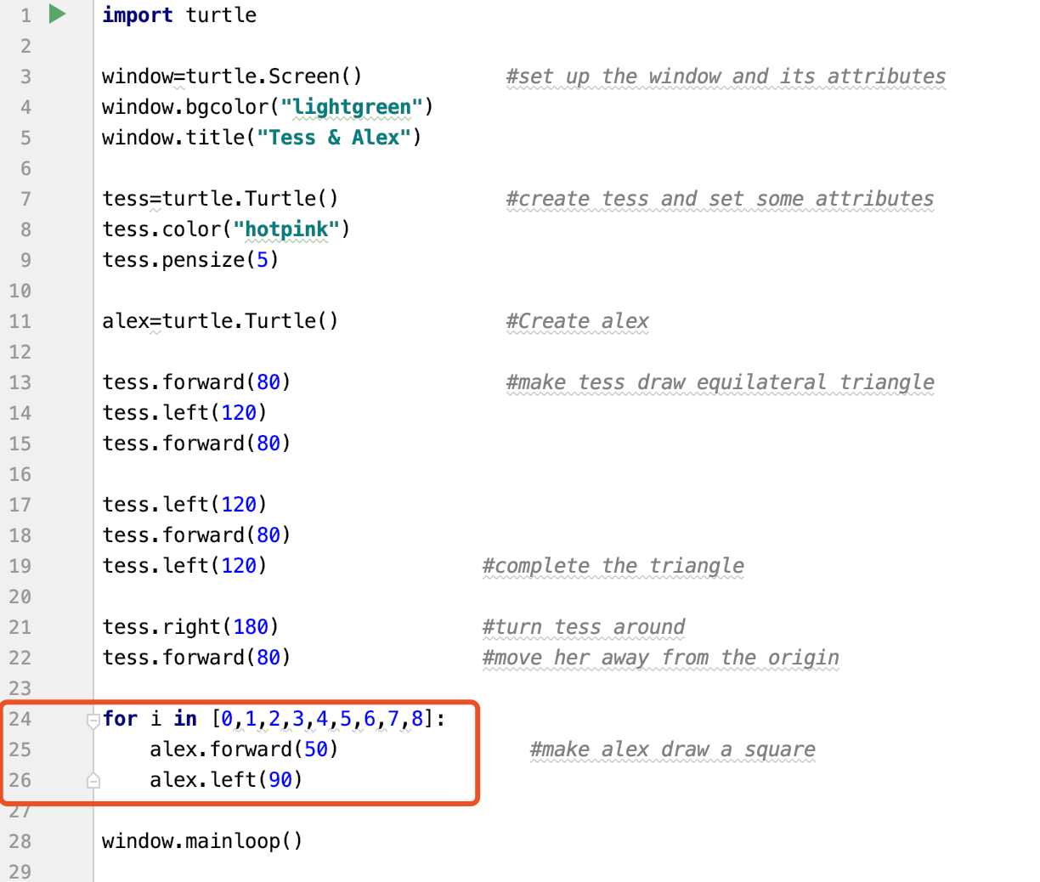
for--improved herd of turtles
for i in range(8)
for _ in range(8)
for color in [“yellow”,”red”,”purple”,”blue”]
alex.color(color)
alex.shape(“turtle”)

Slide 40
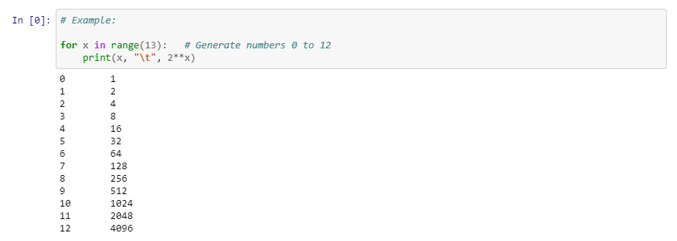
for--Using for loop to print tables

Slide 41
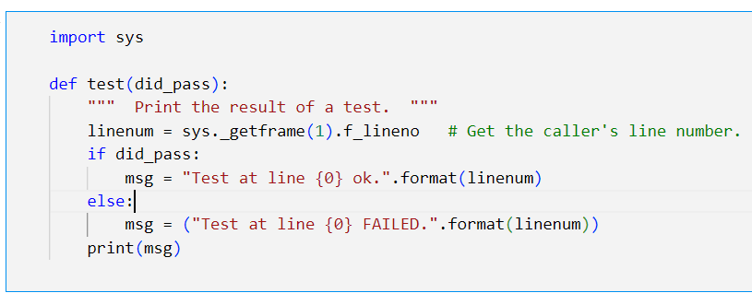
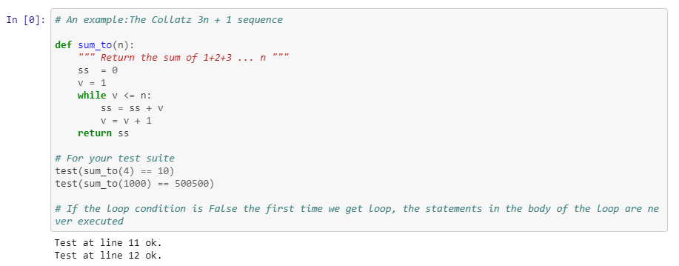
The while statement--Using for loop to print tables
while condition:
statement
Notes:
Is there anyone who can explain the code?
The flow of execution for a while statement:
Evaluate the condition at line 5, yielding a value which is either False or True.
If the value is False, exit the while statement and continue execution at the next statement (line 8 in this case).
If the value is True, execute each of the statements in the body (lines 6 and 7) and then go back to the while statement at line 5.

Slide 42
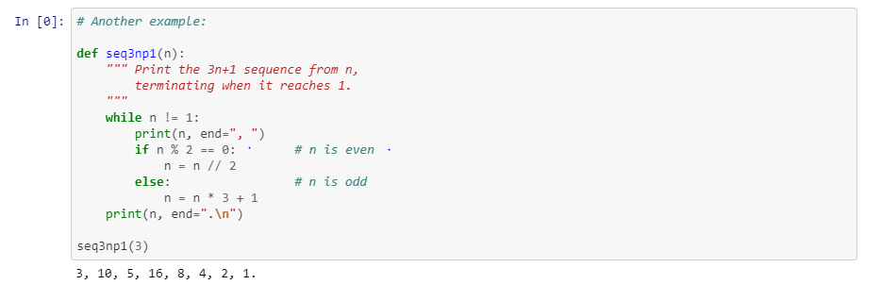
The while statement—Another example
while condition:
statement
Notes:
Is there anyone who can explain the code?
The flow of execution for a while statement:
Evaluate the condition at line 5, yielding a value which is either False or True.
If the value is False, exit the while statement and continue execution at the next statement (line 8 in this case).
If the value is True, execute each of the statements in the body (lines 6 and 7) and then go back to the while statement at line 5.

Slide 43
Question: how to choose between for and while?
Use a for loop if you know, before you start looping, the maximum number of times that you’ll need to execute the body.
So any problem like “iterate this weather model for 1000 cycles”, or “search this list of words”, “find all prime numbers up to 10000” suggest that a for loop is best.
By contrast, if you are required to repeat some computation until some condition is met, and you cannot calculate in advance when (of if) this will happen, as we did in this 3n + 1 problem, you’ll need a while loop.
We call the first case definite iteration — we know ahead of time some definite bounds for what is needed. The latter case is called indefinite iteration — we’re not sure how many iterations we’ll need — we cannot even establish an upper bound!
Notes:
The flow of execution for a while statement:
Evaluate the condition at line 5, yielding a value which is either False or True.
If the value is False, exit the while statement and continue execution at the next statement (line 8 in this case).
If the value is True, execute each of the statements in the body (lines 6 and 7) and then go back to the while statement at line 5.

Slide 44

7
Conditionals

Slide 45
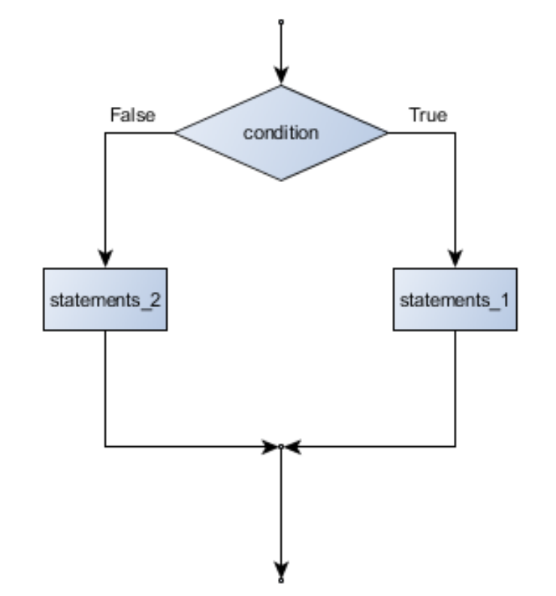
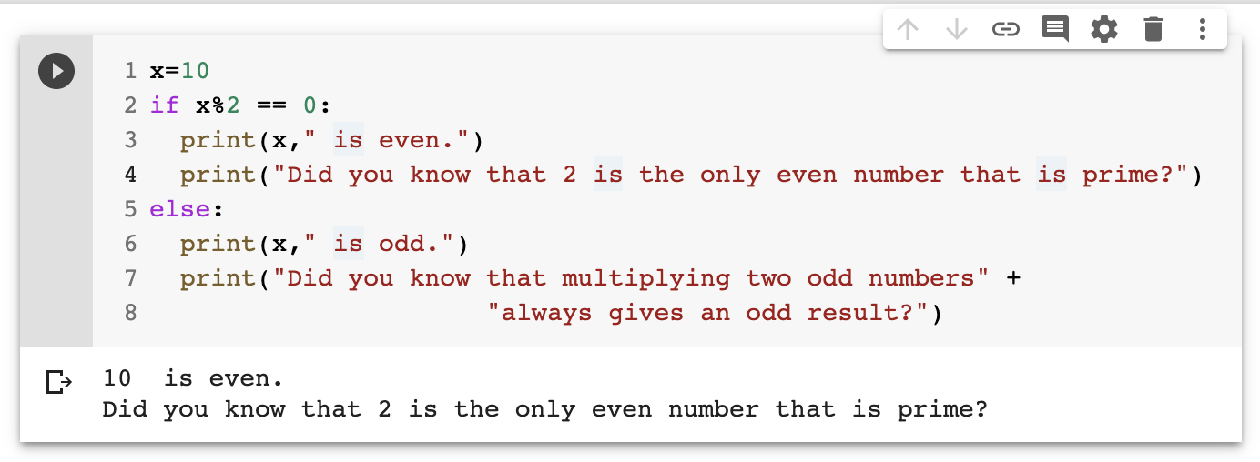
if statement
If boolean expression:
statement_1
else:
statement_2

Slide 46
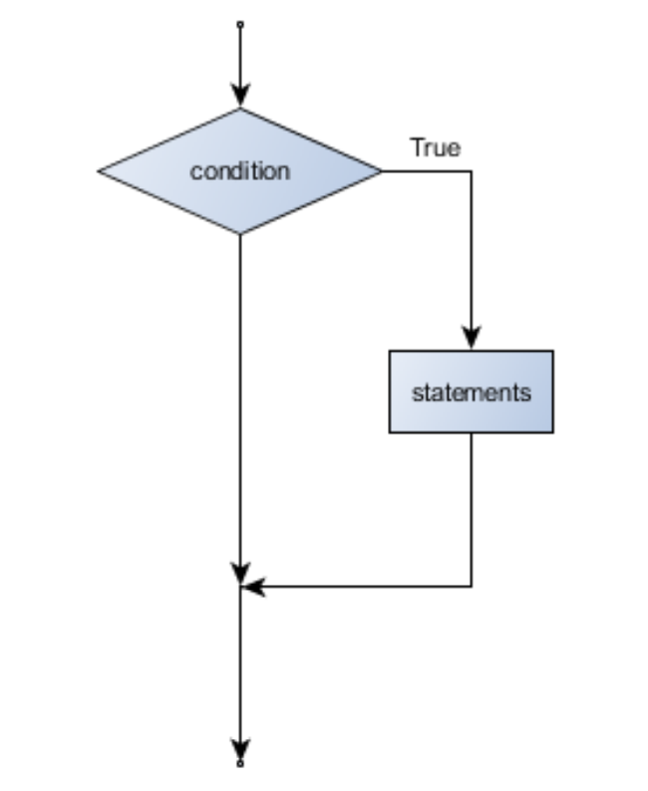
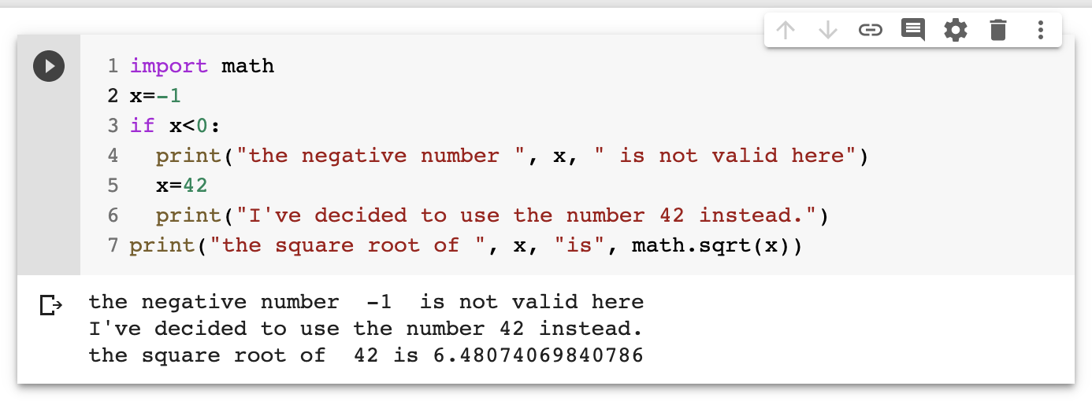
Omitting the else clause
If boolean expression:
statement_1
statement_2

Slide 47


Chained conditionals
If x<y:
statement_1
elif x>y:
statement_2
Else:
statement_3

Slide 48


Nested conditionals
If x<y:
statement_1
else:
if x>y:
statement_2
else:
statement_3

Slide 49


The break statement
The break statement is used to immediately leave the body of its loop.
Notes:
Is there anyone who can explain the code?
The flow of execution for a while statement:
Evaluate the condition at line 5, yielding a value which is either False or True.
If the value is False, exit the while statement and continue execution at the next statement (line 8 in this case).
If the value is True, execute each of the statements in the body (lines 6 and 7) and then go back to the while statement at line 5.

Slide 50


continue statement
continue causes the program to immediately skip the processing of the rest of the body of the loop

Slide 51

pass statement
pass statement is used when a statement is required syntactically but you do not want any command or code to execute.
It is like null operation, as nothing will happen is it is executed
Notes:
As the name suggests pass statement simply does nothing.

Slide 52


Question: What's the difference between "break" and "continue" in Python?
Break: Jumps out of the closest enclosing loop (past the entire loop statement)
Continue: Jumps to the top of the closest enclosing loop (to the loop’s header line)
Notes:
Is there anyone who can explain the code?
The flow of execution for a while statement:
Evaluate the condition at line 5, yielding a value which is either False or True.
If the value is False, exit the while statement and continue execution at the next statement (line 8 in this case).
If the value is True, execute each of the statements in the body (lines 6 and 7) and then go back to the while statement at line 5.

Slide 53

8
In-class Quiz 1

Slide 54
In-class Exercise
Can be accessed on Canvas!

Slide 55
Thank you

